Slide 1


International Islamic University Chittagong
CSE-1222
Project Presentation Team-02
Submitted To:
Mohammed Nazmul Arefin
Assistance Lecturer
Dept of CSE, IIUC
Intro Slide: 01

Slide 2

Team Members
Mostafa Shahriar Asif ID : C201014 c201014@ugrad.iiuc.ac.bd
Md. Sorowar Mahabub ID : C201032 c201032@ugrad.iiuc.ac.bd
Mohammad Shahin Shah ID : C201035 c201035@ugrad.iiuc.ac.bd
Intro Slide: 02

Slide 3
Project Description
MO’ RASA is a comic lover. He has a fantasy of reading & collecting Comics. He has a personal comic collection. He named it as SAS Comics Collection. He often ADD & DISPLAY new comics in his collection. Sometimes he needs to SEARCH a specific comic series & see Available Comics after lending to someone. For all this process he needs your help to build a program to make his doings easy. Now make a program that fulfill all his needs & setup an EXIT system when he is done.
Slide No: 01

Slide 4
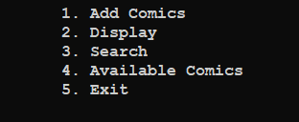
Project Feature
Following Features will be display in our program
Slide No: 02

Slide 5
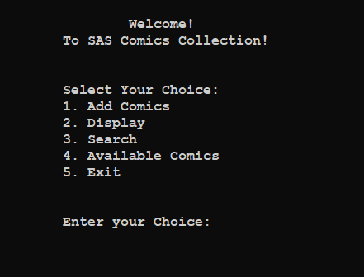
Project Process
After Running our Project file (.cpp), we can see a window like beside:
Slide No: 03

Slide 6
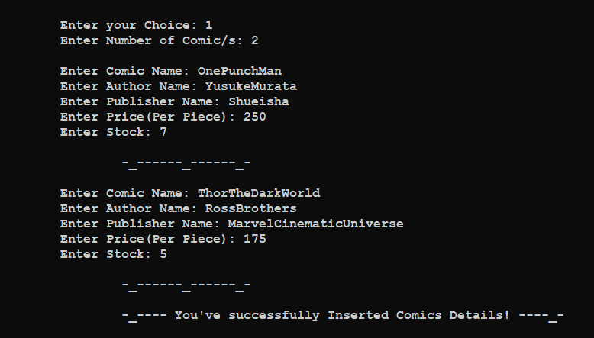
Project Process
If user’s Choice is 1(1. Add Comics), the right-side window will appear, and user will place his/her input:
Slide No: 04

Slide 7
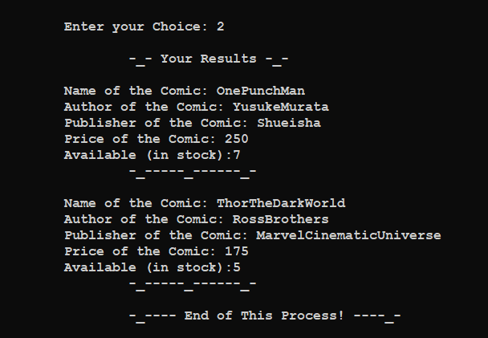
Project Process
After adding data successfully to Add Comics, now If user’s Choice is 2 ( 2. Display), the result will appear that will show what kind of comics are available & also what are they, Available stock, Price etc.
Slide No: 05

Slide 8
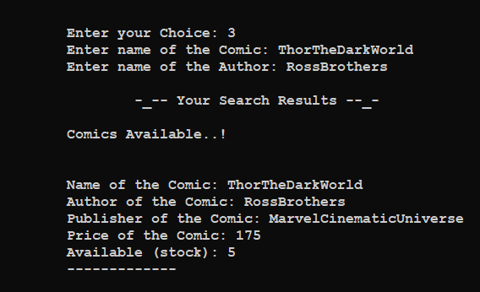
Project Process
Now, if user want to search any specific comics, ha has to Enter 3 ( 3. Search ) as his choice. Then the respective search will appear in the upcoming window. If nothing found, it will terminate automatically, & will show you the home window again.
Slide No: 06

Slide 9
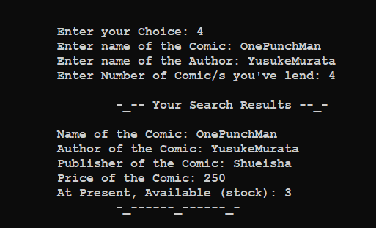
Project Process
If he lend any book to someone then he can update his available stock by choosing 4 (4. Available Comics).
Slide No: 07

Slide 10
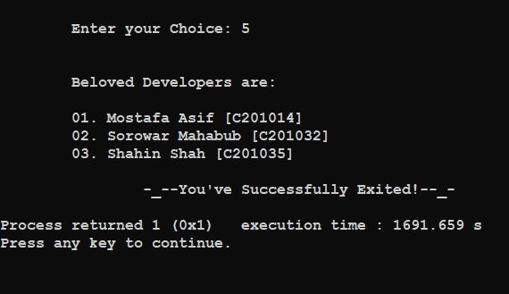
Project Termination
Finally, if you want to exit, you have to choose 5 ( 5. Exit ) to exit, & the compiler will show you the developers details & exit.
Slide No: 08

Slide 11
Sample Input
ThorTheDarkWorld
RossBrothers
MarvelCinematicUniverse
250
7
OnePunchMan
YusukeMurata
Shueisha
175
5
Sample Working Input
Slide No: 09

Slide 12
Ending Slide
Thanks a lot.
Jajakallah Khairan Allah Hafiz.
Assalamu ‘alaikum waa- Rahmatullahi waa- Barak’ atuhu
Slide No: 10
Submission Date: 27/02/2021

